Slide 1
NM _dashboard
File created on: 10/30/2023 4:50:09 AM

Slide 2
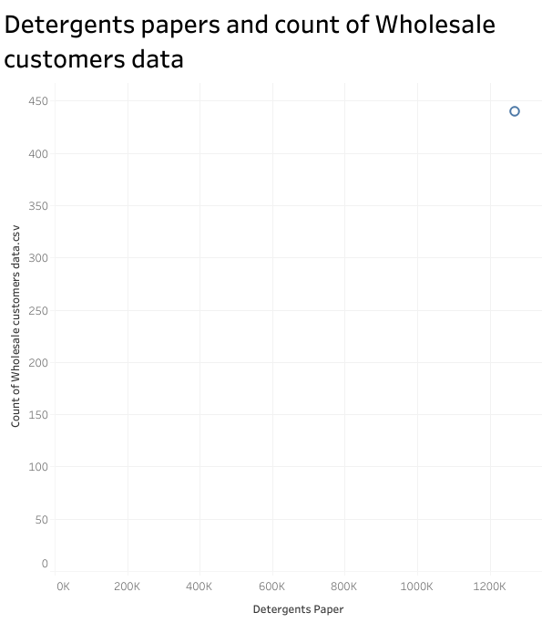

Slide 3
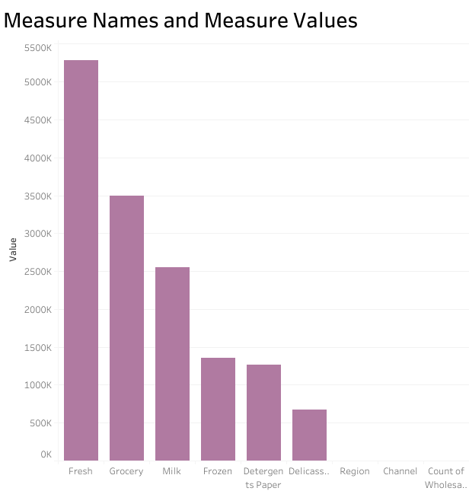

Slide 4


Slide 5
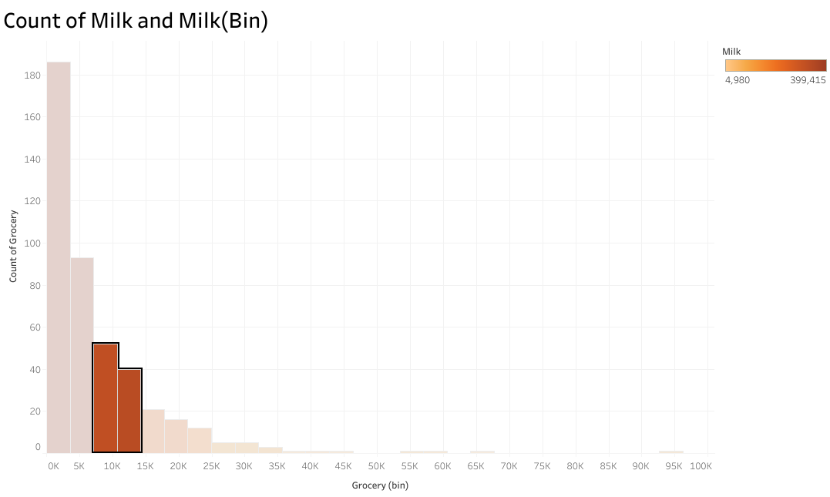

Slide 6
